Slide 1
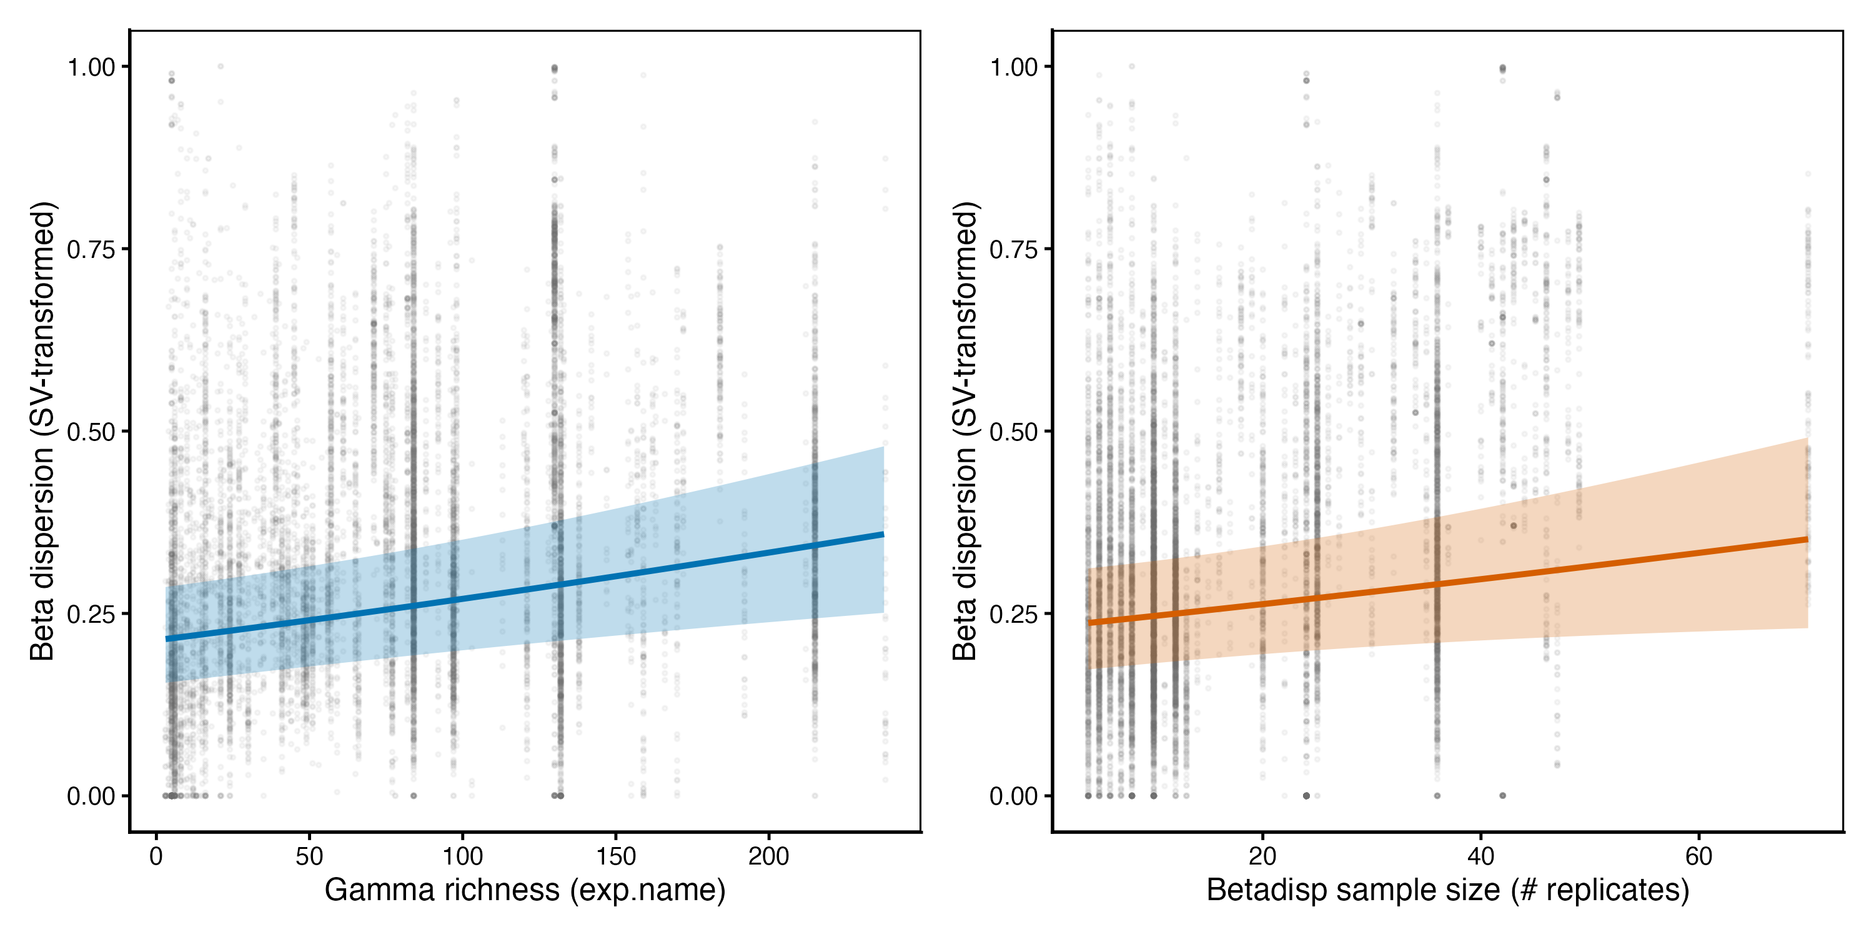
*
*

Slide 2


*
*
*
NS
*
NS

